Slide 1
Bisection method - Basics

Slide 2
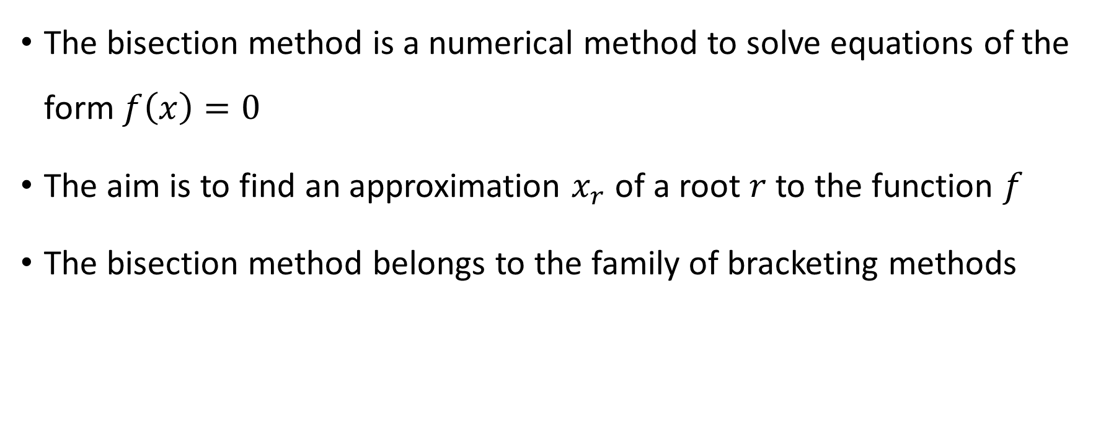
The bisection method is a numerical method to solve equations of the form $f\left(x\right)=0$
The aim is to find an approximation $x_{r}$ of a root $r$ to the function $f$
The bisection method belongs to the family of bracketing methods
Notes:
The bisection method is a numerical method to solve equations of the form $f\left(x\right)=0$
The aim is to find an approximation $x_{r}$ of a root $r$ to the function $f$
The bisection method belongs to the family of bracketing methods

Slide 3
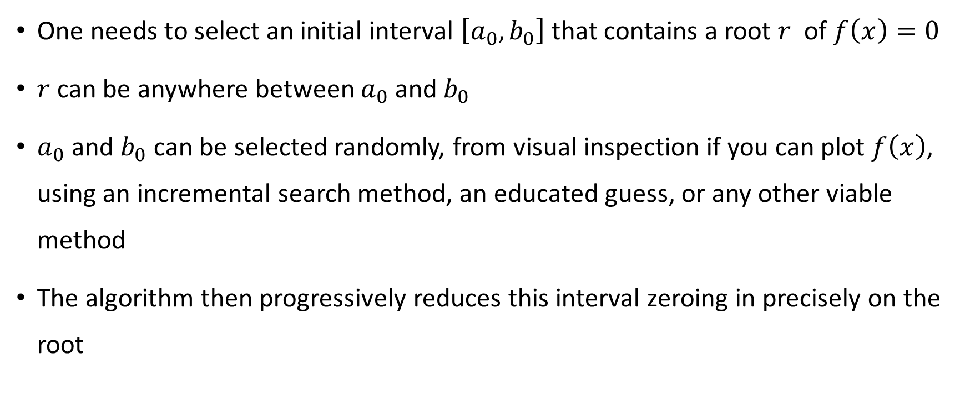
Overview of the method
One needs to select an initial interval $\left[a_{0},b_{0}\right]$ that contains a root $r$ of $f\left(x\right)=0$
$r$can be anywhere between $a_{0}$and${ b}_{0}$
$a_{0}$ and $b_{0}$can be selected randomly, from visual inspection if you can plot $f\left(x\right)$, using an incremental search method, an educated guess, or any other viable method
The algorithm then progressively reduces this interval zeroing in precisely on the root
Notes:
Let us give an overview of the method
First, one needs to select an initial interval $\left[a_{0},b_{0}\right]$ that contains a root $r$ of $f\left(x\right)=0$
To make sure we have a root in that interval we verify that f(a)f(b)<0
Note that $r$can be anywhere between $a_{0}$and${ b}_{0}$
$a_{0}$ and $b_{0}$can be selected randomly, from visual inspection if you can plot $f\left(x\right)$, using an incremental search method, an educated guess, or any other viable method
The algorithm then progressively reduces this interval zeroing in precisely on the root

Slide 4


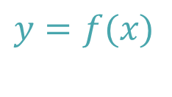









$$y$$
$$y=f(x)$$
$$x_{1}=\frac{a_{1}+b_{1}}{2}$$
$$x_{o}=\frac{a_{o}+b_{o}}{2}$$
[
$$r$$
]
$$a_{o}$$
$$b_{o}$$
$$x$$
[
]
$$a_{1}$$
$$b_{1}$$
[
]
$$a_{2}$$
$$b_{2}$$
Notes:
Let us follow this method graphically
We want to find the root of a given function f.
In our case this root is located in r
We start by selecting an initial interval [ao,bo] bracketing the root
We then compute the midpoint xo of this interval
We then decide if the root is in the left sub-interval [ao,xo] or in the right sub-interval [xo,bo]
In our case the root is in the right interval [xo,bo]
This defines us our new, smaller, interval [a1, b1]
We again compute the midpoint x1 on this interval
Decide if the root is in the left or right sub-interval.
In our case it is in the left sub-interval
This way we find our next, even smaller, interval [a2,b2]
Observe how the algorithm progressively locates more and more precisely the root r.

Slide 5
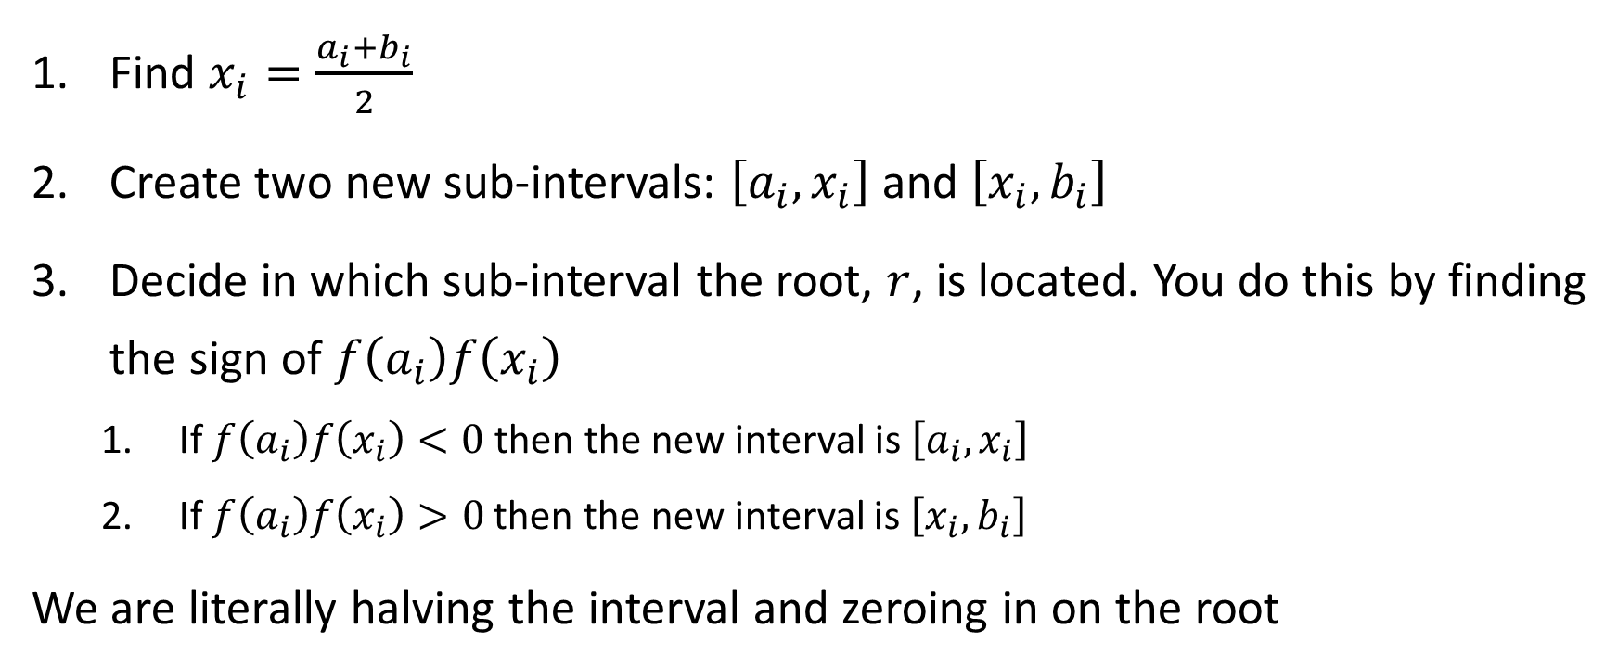
Bisection algorithm
Find $x_{i}=\frac{a_{i}+b_{i}}{2}$
Create two new sub-intervals: $\left[a_{i},x_{i}\right]$ and $\left[x_{i},b_{i}\right]$
Decide in which sub-interval the root, $r$, is located. You do this by finding the sign of $f\left(a_{i}\right)f\left(x_{i}\right)$
If$f\left(a_{i}\right)f\left(x_{i}\right)<0$ then the new interval is $\left[a_{i},x_{i}\right]$
If $f\left(a_{i}\right)f\left(x_{i}\right)>0$ then the new interval is $\left[x_{i},b_{i}\right]$
We are literally halving the interval and zeroing in on the root
Notes:
Let us write down this algorithm in a systematic way:
Step 1: Find $x_{i}=\frac{a_{i}+b_{i}}{2}$
Step 2: Create two new sub-intervals: $\left[a_{i},x_{i}\right]$ and $\left[x_{i},b_{i}\right]$
Step 3 Decide in which sub-interval the root, $r$, is located. You do this by finding the sign of $f\left(a_{i}\right)f\left(x_{i}\right)$
We do this based on the sign of $f\left(a_{i}\right)f\left(x_{i}\right)$:
If$f\left(a_{i}\right)f\left(x_{i}\right)<0$ then the new interval is $\left[a_{i},x_{i}\right]$
If $f\left(a_{i}\right)f\left(x_{i}\right)>0$ then the new interval is $\left[x_{i},b_{i}\right]$
Going back to step 1, with our new interval allows us progressively to locate more and more precisely the root.
We are literally halving the interval and zeroing in on the root in each iteration

Slide 6
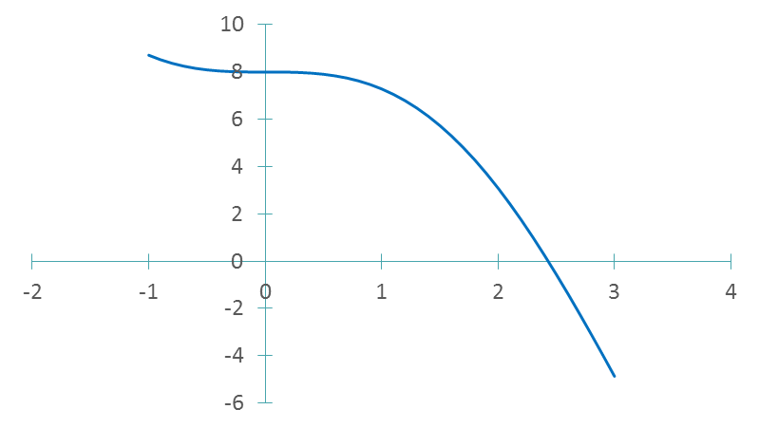




Example
Find the root of the function $f\left(x\right)=8−4.5\left(x−\sin{x}\right)$
$$root$$
[
]
$$a_{o}=2$$
$$b_{o}=3$$
Notes:
Let us illustrate this with an example
Consider the function $f\left(x\right)=8−4.5\left(x−\sin{x}\right)$
Don’t forget to use radians in your calculation for evaluating the trigonometric function.
We start by sketching this function
Based on this sketch we can estimate the approximate location of the root and choose an initial interval [ao,bo] for the bisection algorithm
Let us chose the interval [2,3] as this initial interval.

Slide 7
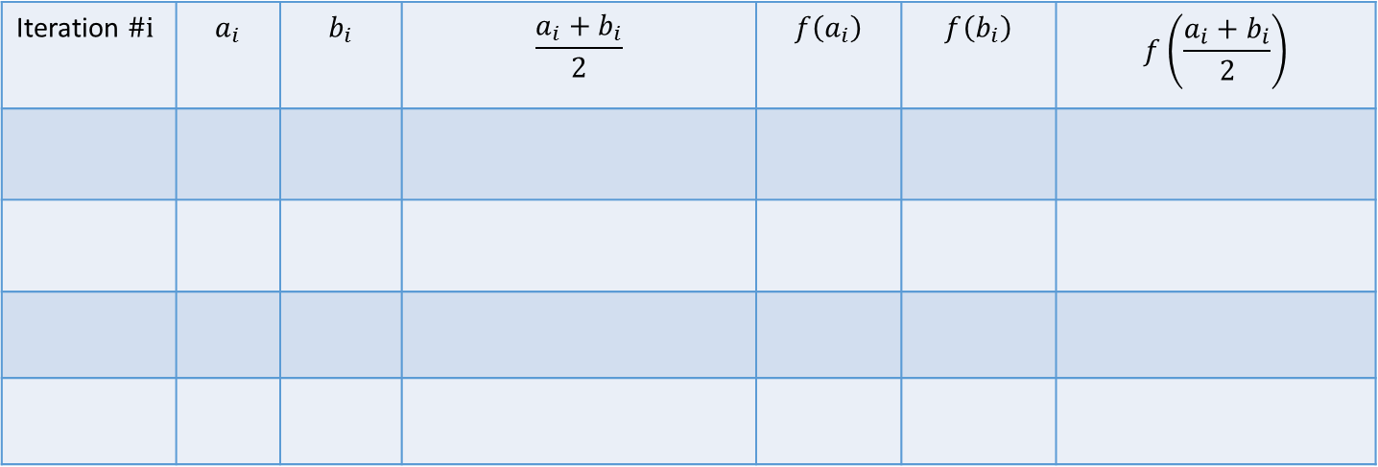
Example
Find the root of the function $f\left(x\right)=8−4.5\left(x−\sin{x}\right)$
Iteration $\#i$ | $$a_{i}$$ | $$b_{i}$$ | $$\frac{a_{i}+b_{i}}{2}$$ | $$f\left(a_{i}\right)$$ | $$f\left(b_{i}\right)$$ | $$f\left(\frac{a_{i}+b_{i}}{2}\right)$$
Notes:
We will organize our calculations in a table

Slide 8
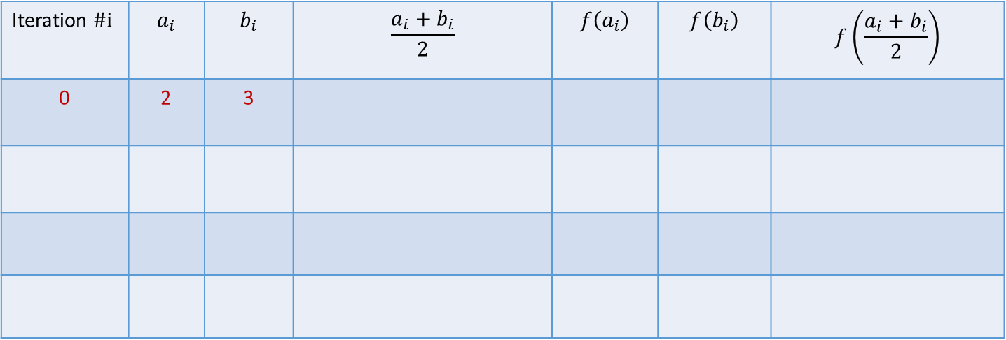



Example
Find the root of the function $f\left(x\right)=8−4.5\left(x−\sin{x}\right)$
Iteration $\#i$ | $$a_{i}$$ | $$b_{i}$$ | $$\frac{a_{i}+b_{i}}{2}$$ | $$f\left(a_{i}\right)$$ | $$f\left(b_{i}\right)$$ | $$f\left(\frac{a_{i}+b_{i}}{2}\right)$$
0 | 2 | 3
$$x$$
$$2$$
$$3$$
Notes:
We start with the interval [2, 3]

Slide 9
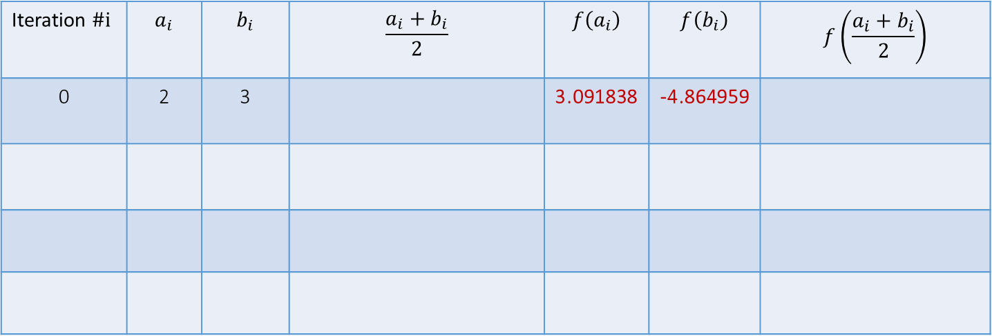
Example
Find the root of the function $f\left(x\right)=8−4.5\left(x−\sin{x}\right)$
Iteration $\#i$ | $$a_{i}$$ | $$b_{i}$$ | $$\frac{a_{i}+b_{i}}{2}$$ | $$f\left(a_{i}\right)$$ | $$f\left(b_{i}\right)$$ | $$f\left(\frac{a_{i}+b_{i}}{2}\right)$$
0 | 2 | 3 |  | 3.091838 | -4.864959
$$x$$
$$2$$
$$3$$
Notes:
Let us compute f(2) and f(3).
Computing f(2) and f(3) shows they are of opposite sign, confirming the interval [2,3] contains a root.

Slide 10
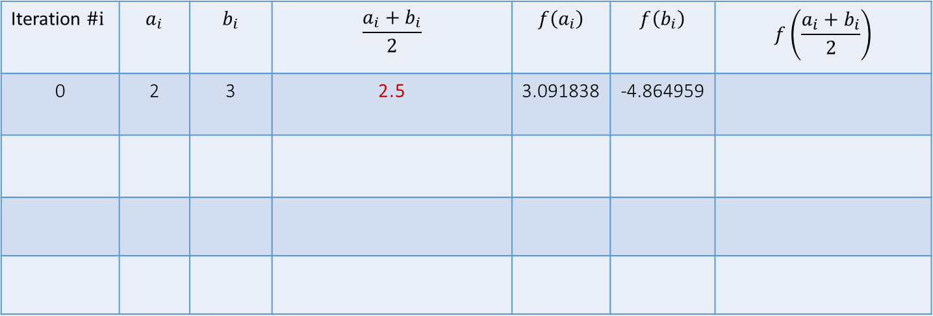
Example
Find the root of the function $f\left(x\right)=8−4.5\left(x−\sin{x}\right)$
Iteration $\#i$ | $$a_{i}$$ | $$b_{i}$$ | $$\frac{a_{i}+b_{i}}{2}$$ | $$f\left(a_{i}\right)$$ | $$f\left(b_{i}\right)$$ | $$f\left(\frac{a_{i}+b_{i}}{2}\right)$$
0 | 2 | 3 | 2.5 | 3.091838 | -4.864959
$$x$$
$$2$$
$$3$$
Notes:
The midpoint of this initial interval is 2.5

Slide 11
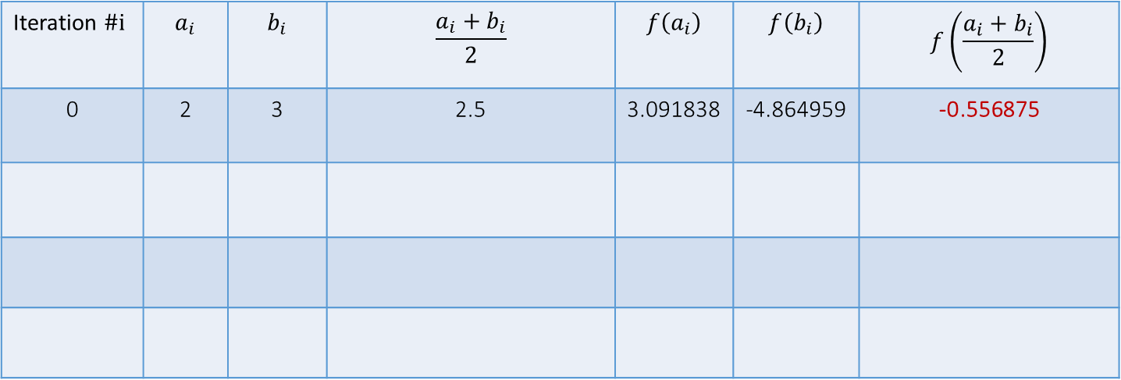
Example
Find the root of the function $f\left(x\right)=8−4.5\left(x−\sin{x}\right)$
Iteration $\#i$ | $$a_{i}$$ | $$b_{i}$$ | $$\frac{a_{i}+b_{i}}{2}$$ | $$f\left(a_{i}\right)$$ | $$f\left(b_{i}\right)$$ | $$f\left(\frac{a_{i}+b_{i}}{2}\right)$$
0 | 2 | 3 | 2.5 | 3.091838 | -4.864959 | -0.556875
$$x$$
$$2$$
$$3$$
Notes:
Let us compute f(2.5)
We get a negative value.
Consequently the interval [2, 2.5] must contain the root, as f(2) and f(2.5) are of opposite signs.

Slide 12
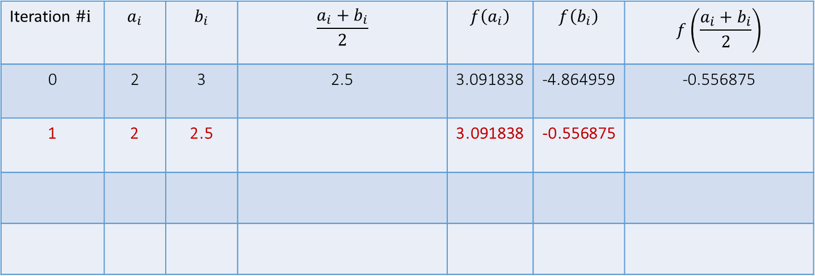

Example
Find the root of the function $f\left(x\right)=8−4.5\left(x−\sin{x}\right)$
Iteration $\#i$ | $$a_{i}$$ | $$b_{i}$$ | $$\frac{a_{i}+b_{i}}{2}$$ | $$f\left(a_{i}\right)$$ | $$f\left(b_{i}\right)$$ | $$f\left(\frac{a_{i}+b_{i}}{2}\right)$$
0 | 2 | 3 | 2.5 | 3.091838 | -4.864959 | -0.556875
1 | 2 | 2.5 |  | 3.091838 | -0.556875
$$x$$
$$2$$
$$3$$
2
$$2.5$$
Notes:
The interval [2, 2.5] is our next interval in the calculations

Slide 13
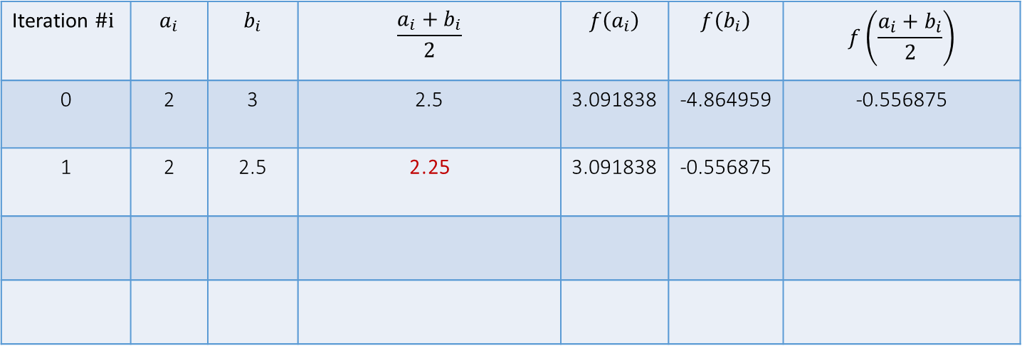
Example
Find the root of the function $f\left(x\right)=8−4.5\left(x−\sin{x}\right)$
Iteration $\#i$ | $$a_{i}$$ | $$b_{i}$$ | $$\frac{a_{i}+b_{i}}{2}$$ | $$f\left(a_{i}\right)$$ | $$f\left(b_{i}\right)$$ | $$f\left(\frac{a_{i}+b_{i}}{2}\right)$$
0 | 2 | 3 | 2.5 | 3.091838 | -4.864959 | -0.556875
1 | 2 | 2.5 | 2.25 | 3.091838 | -0.556875
$$x$$
$$2$$
$$3$$
2
$$2.5$$
Notes:
The midpoint of this interval is 2.25

Slide 14
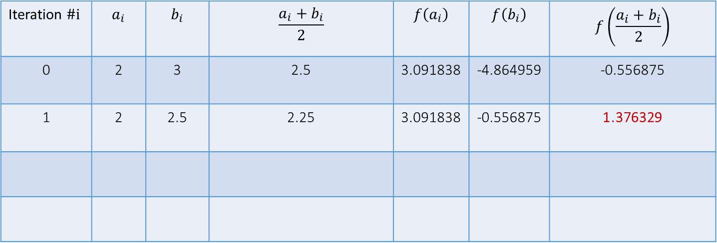
Example
Find the root of the function $f\left(x\right)=8−4.5\left(x−\sin{x}\right)$
Iteration $\#i$ | $$a_{i}$$ | $$b_{i}$$ | $$\frac{a_{i}+b_{i}}{2}$$ | $$f\left(a_{i}\right)$$ | $$f\left(b_{i}\right)$$ | $$f\left(\frac{a_{i}+b_{i}}{2}\right)$$
0 | 2 | 3 | 2.5 | 3.091838 | -4.864959 | -0.556875
1 | 2 | 2.5 | 2.25 | 3.091838 | -0.556875 | 1.376329
$$x$$
$$2$$
$$3$$
2
$$2.5$$
Notes:
And f(2.25) is a positive quantity
Consequently the root is located in the interval [2.25, 2.5]

Slide 15

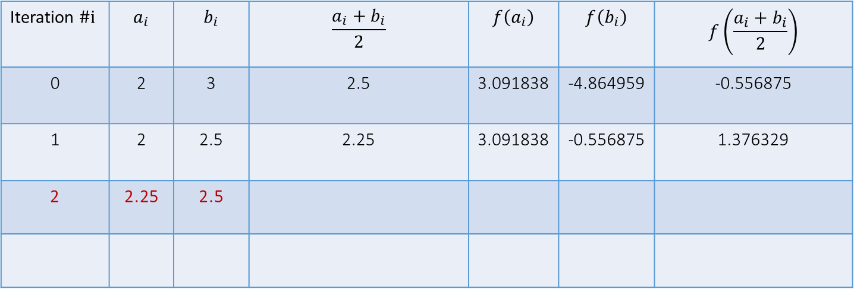

Example
Find the root of the function $f\left(x\right)=8−4.5\left(x−\sin{x}\right)$
Iteration $\#i$ | $$a_{i}$$ | $$b_{i}$$ | $$\frac{a_{i}+b_{i}}{2}$$ | $$f\left(a_{i}\right)$$ | $$f\left(b_{i}\right)$$ | $$f\left(\frac{a_{i}+b_{i}}{2}\right)$$
0 | 2 | 3 | 2.5 | 3.091838 | -4.864959 | -0.556875
1 | 2 | 2.5 | 2.25 | 3.091838 | -0.556875 | 1.376329
2 | 2.25 | 2.5
$$x$$
$$2$$
$$3$$
2
$$2.5$$
$$2.25$$
$$2.5$$
Notes:
[2.25, 2.5] becomes our next interval.
From here on you can proceed further the same way we did until now.

Slide 16

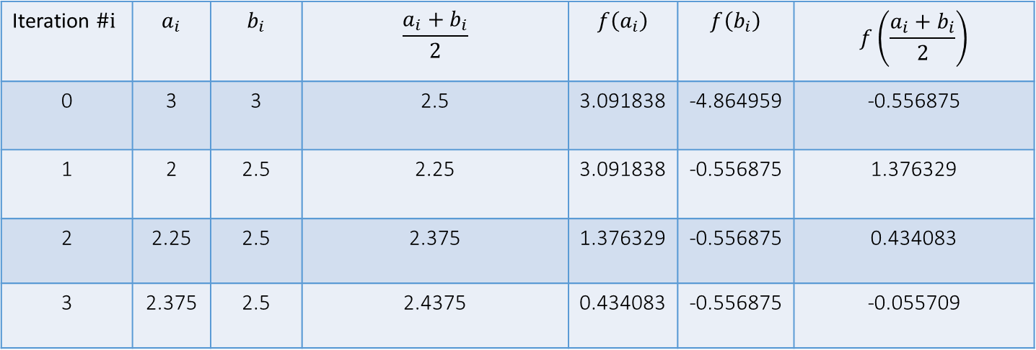






Example
Find the root of the function $f\left(x\right)=8−4.5\left(x−\sin{x}\right)$
Iteration $\#i$ | $$a_{i}$$ | $$b_{i}$$ | $$\frac{a_{i}+b_{i}}{2}$$ | $$f\left(a_{i}\right)$$ | $$f\left(b_{i}\right)$$ | $$f\left(\frac{a_{i}+b_{i}}{2}\right)$$
0 | 3 | 3 | 2.5 | 3.091838 | -4.864959 | -0.556875
1 | 2 | 2.5 | 2.25 | 3.091838 | -0.556875 | 1.376329
2 | 2.25 | 2.5 | 2.375 | 1.376329 | -0.556875 | 0.434083
3 | 2.375 | 2.5 | 2.4375 | 0.434083 | -0.556875 | -0.055709
$$x$$
$$2$$
$$3$$
2
$$2.5$$
$$2.25$$
$$2.5$$
$$2.375$$
$$2.5$$
Notes:
Here we show how looks the first three iterations
Observe how the interval bracketing the root becomes smaller and smaller.

Slide 17
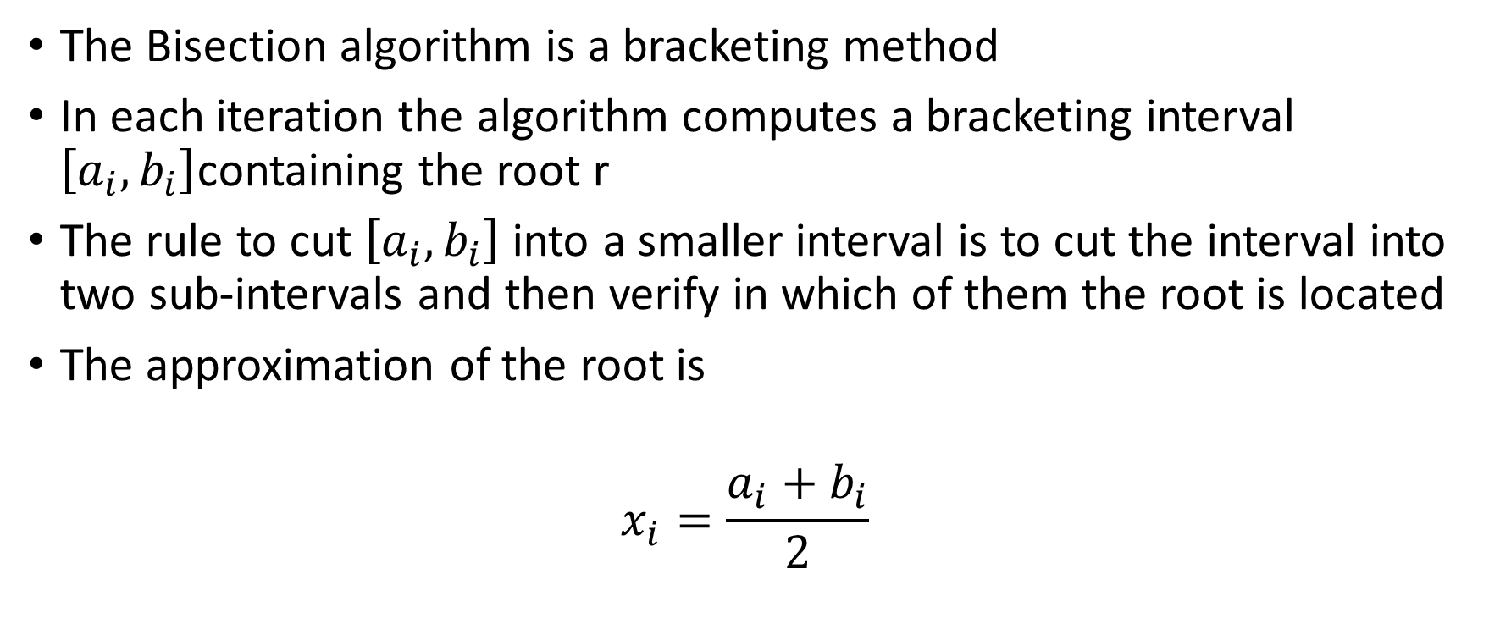
Summary
The Bisection algorithm is a bracketing method
In each iteration the algorithm computes a bracketing interval $\left[a_{i},b_{i}\right]$containing the root r
The rule to cut $\left[a_{i},b_{i}\right]$ into a smaller interval is to cut the interval into two sub-intervals and then verify in which of them the root is located
The approximation of the root is
$$x_{i}=\frac{a_{i}+b_{i}}{2}$$
Notes:
Let us summarize the key findings:
The Bisection algorithm is a bracketing method
In each iteration the algorithm computes a bracketing interval $\left[a_{i},b_{i}\right]$containing the root r
The rule to cut $\left[a_{i},b_{i}\right]$ into a smaller interval is to cut the interval into two sub-intervals and then verify in which of them the root is located
The approximation of the root is $x_{i}=\frac{a_{i}+b_{i}}{2}$

